Slide 1



Improving on PFP: AuPair
Background
PFP
AuPair
Motivation
TS Graph
Costs
Example
Experiments
Requirements
Compression
Effects of w and p
Marco Oliva¹, Davide Cenzato², Massimiliano Rossi¹, Travis Gagie³ and Christina Boucher¹
¹ Department of Computer and Information Science, University of Florida
² Department of Computer Science, University of Verona
³ Department of Computer Science, Dalhousie University

Slide 2
  Prefix Free Parsing
Background
PFP
AuPair
Motivation
TS Graph
Costs
Example
Experiments
Requirements
Compression
Effects of w and p
To build the r-index (BWT and SA) | [Kuhnle et al. 2019]
As a data structure to support LCE, SA, LCP and BWT in O(PFP(T)) | [Boucher et al. 2021]
Full CST functionalities
MONI | [Rossi et al. 2021]
PHONI
more…

Slide 3
  Prefix Free Parsing
Background
PFP
AuPair
Motivation
TS Graph
Costs
Example
Experiments
Requirements
Compression
Effects of w and p
S: AAGGTNTATACCTTCCCAGGTAACAAACCAACCAA$
AAGGTNTATACCTTCCCAGGTAAAAAACCAACCAA$
AAGGTNTATACCTTCCCAGGTAATAAACCAACCAA$
W: 2
TS: {‘NT’, ‘AG’, ‘A$’, ‘##’}

Slide 4
  Prefix Free Parsing
Background
PFP
AuPair
Motivation
TS Graph
Costs
Example
Experiments
Requirements
Compression
Effects of w and p
S: #AAGGTNTATACCTTCCCAGGTAACAAACCAACCAA$
AAGGTNTATACCTTCCCAGGTAAAAAACCAACCAA$
AAGGTNTATACCTTCCCAGGTAATAAACCAACCAA$##
W: 2
TS: {‘NT’, ‘AG’, ‘A$’, ‘##’}

Slide 5
  Prefix Free Parsing
Background
PFP
AuPair
Motivation
TS Graph
Costs
Example
Experiments
Requirements
Compression
Effects of w and p
S: #AAGGTNTATACCTTCCCAGGTAACAAACCAACCAA$
AAGGTNTATACCTTCCCAGGTAAAAAACCAACCAA$
AAGGTNTATACCTTCCCAGGTAATAAACCAACCAA$##
W: 2
TS: {‘NT’, ‘AG’, ‘A$’, ‘##’}

Slide 6
  Prefix Free Parsing
Background
PFP
AuPair
Motivation
TS Graph
Costs
Example
Experiments
Requirements
Compression
Effects of w and p
S: #AAGGTNTATACCTTCCCAGGTAACAAACCAACCAA$
AAGGTNTATACCTTCCCAGGTAAAAAACCAACCAA$
AAGGTNTATACCTTCCCAGGTAATAAACCAACCAA$##
W: 2
TS: {‘NT’, ‘AG’, ‘A$’, ‘##’}
D: {#AAG}
P: [h(#AAG)]

Slide 7
  Prefix Free Parsing
Background
PFP
AuPair
Motivation
TS Graph
Costs
Example
Experiments
Requirements
Compression
Effects of w and p
S: #AAGGTNTATACCTTCCCAGGTAACAAACCAACCAA$
AAGGTNTATACCTTCCCAGGTAAAAAACCAACCAA$
AAGGTNTATACCTTCCCAGGTAATAAACCAACCAA$##
W: 2
TS: {‘NT’, ‘AG’, ‘A$’, ‘##’}
D: {#AAG, A$##, A$AAG, AGGTAAAAAACCAACCAA$,
AGGTAACAAACCAACCAA$, AGGTAATAAACCAACCAA$,
AGGTNT, NTATACCTTCCCAG}
P: [1, 7, 8, 5, 3, 7, 8, 4, 3, 7, 8, 6, 2]

Slide 8
  Prefix Free Parsing
Background
PFP
AuPair
Motivation
TS Graph
Costs
Example
Experiments
Requirements
Compression
Effects of w and p
S: #AAGGTNTATACCTTCCCAGGTAACAAACCAACCAA$
AAGGTNTATACCTTCCCAGGTAAAAAACCAACCAA$
AAGGTNTATACCTTCCCAGGTAATAAACCAACCAA$##
W: 2
TS: {‘NT’, ‘AG’, ‘A$’, ‘##’}
D: {#AAG, A$##, A$AAG, AGGTAAAAAACCAACCAA$,
AGGTAACAAACCAACCAA$, AGGTAATAAACCAACCAA$,
AGGTNT, NTATACCTTCCCAG}
P: [1, 7, 8, 5, 3, 7, 8, 4, 3, 7, 8, 6, 2]

Slide 9
  Prefix Free Parsing
Background
PFP
AuPair
Motivation
TS Graph
Costs
Example
Experiments
Requirements
Compression
Effects of w and p
S: #AAGGTNTATACCTTCCCAGGTAACAAACCAACCAA$
AAGGTNTATACCTTCCCAGGTAAAAAACCAACCAA$
AAGGTNTATACCTTCCCAGGTAATAAACCAACCAA$##
W: 2
TS: {‘NT’, ‘AG’, ‘A$’, ‘##’}
D: {#AAG, A$##, A$AAG, AGGTAAAAAACCAACCAA$,
AGGTAACAAACCAACCAA$, AGGTAATAAACCAACCAA$,
AGGTNT, NTATACCTTCCCAG}
P: [1, 7, 8, 5, 3, 7, 8, 4, 3, 7, 8, 6, 2]

Slide 10
  Motivation
Background
PFP
AuPair
Motivation
TS Graph
Costs
Example
Experiments
Requirements
Compression
Effects of w and p
S: #AAGGTNTATACCTTCCCAGGTAACAAACCAACCAA$
AAGGTNTATACCTTCCCAGGTAAGAAACCAACCAA$
AAGGTNTATACCTTCCCAGGTAATAAACCAACCAA$##
W: 2
TS: {‘NT’, ‘AG’, ‘A$’, ‘##’}

Slide 11
  Trigger Strings Graph
Background
PFP
AuPair
Motivation
TS Graph
Costs
Example
Experiments
Requirements
Compression
Effects of w and p
D: {#AAG, A$##, A$AAG, AGGTAAAAAACCAACCAA$,
AGGTAACAAACCAACCAA$, AGGTAATAAACCAACCAA$,
AGGTNT, NTATACCTTCCCAG}
P: [1, 7, 8, 5, 3, 7, 8, 4, 3, 7, 8, 6, 2]
#A
AG
A$
##
NT

Slide 12
  AuPair
Background
PFP
AuPair
Motivation
TS Graph
Costs
Example
Experiments
Requirements
Compression
Effects of w and p
D: {#AAG, A$##, A$AAG, AGGTAAAAAACCAACCAA$,
AGGTAACAAACCAACCAA$, AGGTAATAAACCAACCAA$,
AGGTNT, NTATACCTTCCCAG}
P: [1, 7, 8, 5, 3, 7, 8, 4, 3, 7, 8, 6, 2]
Pairs: [(1,7)(7,8)(8,5)(5,3)(3,7)(7,8)(8,4)(4,3),
(3,7)(7,8)(8,6)(6,2)]

Slide 13
  AuPair
Background
PFP
AuPair
Motivation
TS Graph
Costs
Example
Experiments
Requirements
Compression
Effects of w and p
D: {#AAG, A$##, A$AAG, AGGTAAAAAACCAACCAA$,
AGGTAACAAACCAACCAA$, AGGTAATAAACCAACCAA$,
AGGTNT, NTATACCTTCCCAG}
P: [1, 7, 8, 5, 3, 7, 8, 4, 3, 7, 8, 6, 2]
Pairs: [(1,7)(7,8)(8,5)(5,3)(3,7)(7,8)(8,4)(4,3),
(3,7)(7,8)(8,6)(6,2)]
TS: {
‘##’: -
‘#A’: -
‘NT’: (7,8)₃
‘AG’: (3,7)₂(1,7)₁(8,4)₁(8,5)₁(8,6)₁
‘A$’: (4,3)₁(5,3)₁(6,2)₁
}

Slide 14
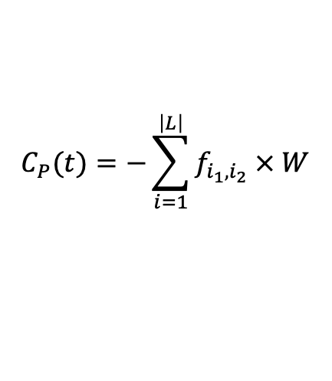

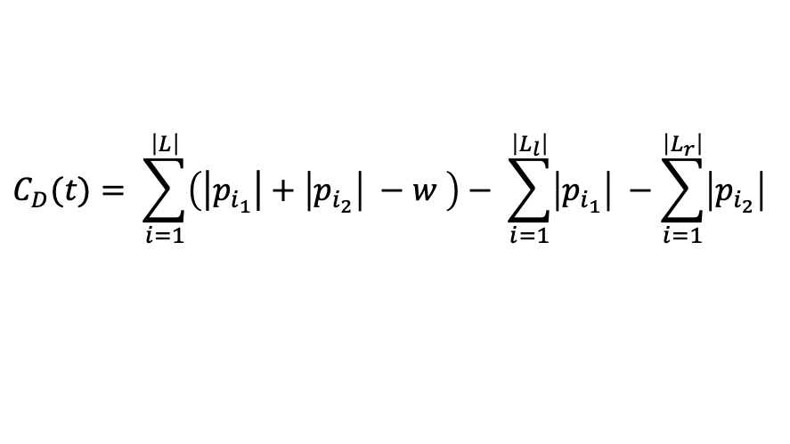
  AuPair
Background
PFP
AuPair
Motivation
TS Graph
Costs
Example
Experiments
Requirements
Compression
Effects of w and p
$$C\left(t\right)=C_{P}\left(t\right)+C_{D}(t)$$
$$C_{P}(t)=−\sum_{i=1}^{\left|L\right|}{f_{i_{1},i_{2}} × W}$$
$$C_{D}(t)= \sum_{i=1}^{\left|L\right|}{\left(\left|\left.p_{i_{1}}\right|+\left|p_{i_{2}}\right| −w \right.\right)− \sum_{i=1}^{\left|L_{l}\right|}{\left|p_{i_{1}}\right|} −\sum_{i=1}^{\left|L_{r}\right|}{\left|p_{i_{2}}\right|}}$$

Slide 15
  AuPair
Background
PFP
AuPair
Motivation
TS Graph
Costs
Example
Experiments
Requirements
Compression
Effects of w and p
D: {#AAG, A$##, A$AAG, AGGTAAAAAACCAACCAA$,
AGGTAACAAACCAACCAA$, AGGTAATAAACCAACCAA$,
AGGTNT, NTATACCTTCCCAG}
P: [1, 7, 8, 5, 3, 7, 8, 4, 3, 7, 8, 6, 2]
Pairs: [(1,7)(7,8)(8,5)(5,3)(3,7)(7,8)(8,4)(4,3),
(3,7)(7,8)(8,6)(6,2)]
TS: {
‘##’: - C(##) = 0
‘#A’: - C(#A) = 0
‘NT’: (7,8)₃ C(NT) = -14
‘AG’: (3,7)₂(1,7)₁(8,4)₁(8,5)₁(8,6)₁ C(AG) = 0
‘A$’: (4,3)₁(5,3)₁(6,2)₁ C(A$) = -1
}

Slide 16
  AuPair
Background
PFP
AuPair
Motivation
TS Graph
Costs
Example
Experiments
Requirements
Compression
Effects of w and p
D: {#AAG, A$##, A$AAG, AGGTAAAAAACCAACCAA$,
AGGTAACAAACCAACCAA$, AGGTAATAAACCAACCAA$,
AGGTNT, NTATACCTTCCCAG}
P: [1, 7, 8, 5, 3, 7, 8, 4, 3, 7, 8, 6, 2]
Pairs: [(1,7)(7,8)(8,5)(5,3)(3,7)(7,8)(8,4)(4,3),
(3,7)(7,8)(8,6)(6,2)]
TS: {
‘##’: - C(##) = 0
‘#A’: - C(#A) = 0
‘NT’: (7,8)₃ C(NT) = -14
‘AG’: (3,7)₂(1,7)₁(8,4)₁(8,5)₁(8,6)₁ C(AG) = 0
‘A$’: (4,3)₁(5,3)₁(6,2)₁ C(A$) = -1
}

Slide 17
  AuPair
Background
PFP
AuPair
Motivation
TS Graph
Costs
Example
Experiments
Requirements
Compression
Effects of w and p
D: {#AAG, A$##, A$AAG, AGGTAAAAAACCAACCAA$,
AGGTAACAAACCAACCAA$, AGGTAATAAACCAACCAA$,
AGGTNT, NTATACCTTCCCAG}
P: [1, 7, 8, 5, 3, 7, 8, 4, 3, 7, 8, 6, 2]
Pairs: [(1,7)(7,8)(8,5)(5,3)(3,7)(7,8)(8,4)(4,3),
(3,7)(7,8)(8,6)(6,2)]
TS: {
‘##’: - C(##) = 0
‘#A’: - C(#A) = 0
‘NT’: (7,8)₃ C(NT) = -14
‘AG’: (3,7)₂(1,7)₁(8,4)₁(8,5)₁(8,6)₁ C(AG) = 0
‘A$’: (4,3)₁(5,3)₁(6,2)₁ C(A$) = -1
}

Slide 18
  AuPair
Background
PFP
AuPair
Motivation
TS Graph
Costs
Example
Experiments
Requirements
Compression
Effects of w and p
D: {#AAG, A$##, A$AAG, AGGTAAAAAACCAACCAA$,
AGGTAACAAACCAACCAA$, AGGTAATAAACCAACCAA$,
AGGTNTATACCTTCCCAG}
P: [1, 7, 8, 5, 3, 7, 8, 4, 3, 7, 8, 6, 2]
Pairs: [(1,7)(7,8)(8,5)(5,3)(3,7)(7,8)(8,4)(4,3),
(3,7)(7,8)(8,6)(6,2)]
TS: {
‘##’: - C(##) = 0
‘#A’: - C(#A) = 0
‘NT’: (7,8)₃ C(NT) = -14
‘AG’: (3,7)₂(1,7)₁(8,4)₁(8,5)₁(8,6)₁ C(AG) = 0
‘A$’: (4,3)₁(5,3)₁(6,2)₁ C(A$) = -1
}

Slide 19
  AuPair
Background
PFP
AuPair
Motivation
TS Graph
Costs
Example
Experiments
Requirements
Compression
Effects of w and p
D: {#AAG, A$##, A$AAG, AGGTAAAAAACCAACCAA$,
AGGTAACAAACCAACCAA$, AGGTAATAAACCAACCAA$,
AGGTNTATACCTTCCCAG}
P: [1, 7, 8, 5, 3, 7, 8, 4, 3, 7, 8, 6, 2]
Pairs: [(1,7)(7,8)(8,5)(5,3)(3,7)(7,8)(8,4)(4,3),
(3,7)(7,8)(8,6)(6,2)]
TS: {
‘##’: - C(##) = 0
‘#A’: - C(#A) = 0
‘NT’: (7,8)₃ C(NT) = -14
‘AG’: (3,7)₂(1,7)₁(8,4)₁(8,5)₁(8,6)₁ C(AG) = 0
‘A$’: (4,3)₁(5,3)₁(6,2)₁ C(A$) = -1
}

Slide 20
  AuPair
Background
PFP
AuPair
Motivation
TS Graph
Costs
Example
Experiments
Requirements
Compression
Effects of w and p
D: {#AAG, A$##, A$AAG, AGGTAAAAAACCAACCAA$,
AGGTAACAAACCAACCAA$, AGGTAATAAACCAACCAA$,
AGGTNTATACCTTCCCAG}
P: [1, 7, M, 5, 3, 7, M, 4, 3, 7, M, 6, 2]
Pairs: [(1,7)(7,8)(8,5)(5,3)(3,7)(7,8)(8,4)(4,3),
(3,7)(7,8)(8,6)(6,2)]
TS: {
‘##’: - C(##) = 0
‘#A’: - C(#A) = 0
‘NT’: (7,8)₃ C(NT) = -14
‘AG’: (3,7)₂(1,7)₁(8,4)₁(8,5)₁(8,6)₁ C(AG) = 0
‘A$’: (4,3)₁(5,3)₁(6,2)₁ C(A$) = -1
}

Slide 21
  AuPair
Background
PFP
AuPair
Motivation
TS Graph
Costs
Example
Experiments
Requirements
Compression
Effects of w and p
D: {#AAG, A$##, A$AAG, AGGTAAAAAACCAACCAA$,
AGGTAACAAACCAACCAA$, AGGTAATAAACCAACCAA$,
AGGTNTATACCTTCCCAG}
P: [1, M, 5, 3, M, 4, 3, M, 6, 2]
Pairs: [(1,7)(7,8)(8,5)(5,3)(3,7)(7,8)(8,4)(4,3),
(3,7)(7,8)(8,6)(6,2)]
TS: {
‘##’: - C(##) = 0
‘#A’: - C(#A) = 0
‘NT’: (7,8)₃ C(NT) = -14
‘AG’: (3,7)₂(1,7)₁(8,4)₁(8,5)₁(8,6)₁ C(AG) = 0
‘A$’: (4,3)₁(5,3)₁(6,2)₁ C(A$) = -1
}

Slide 22
  AuPair
Background
PFP
AuPair
Motivation
TS Graph
Costs
Example
Experiments
Requirements
Compression
Effects of w and p
D: {#AAG, A$##, A$AAG, AGGTAAAAAACCAACCAA$,
AGGTAACAAACCAACCAA$, AGGTAATAAACCAACCAA$,
AGGTNTATACCTTCCCAG}
P: [1, M, 5, 3, M, 4, 3, M, 6, 2]
Pairs: [(1,7)(8,5)(5,3)(3,7)(8,4)(4,3)(3,7)(8,6)(6,2)]
TS: {
‘##’: - C(##) = 0
‘#A’: - C(#A) = 0
‘NT’: (7,8)₃ C(NT) = -14
‘AG’: (3,7)₂(1,7)₁(8,4)₁(8,5)₁(8,6)₁ C(AG) = 0
‘A$’: (4,3)₁(5,3)₁(6,2)₁ C(A$) = -1
}

Slide 23
  AuPair
Background
PFP
AuPair
Motivation
TS Graph
Costs
Example
Experiments
Requirements
Compression
Effects of w and p
D: {#AAG, A$##, A$AAG, AGGTAAAAAACCAACCAA$,
AGGTAACAAACCAACCAA$, AGGTAATAAACCAACCAA$,
AGGTNTATACCTTCCCAG}
P: [1, M, 5, 3, M, 4, 3, M, 6, 2]
Pairs: [(1,M)(M,5)(5,3)(3,M)(M,4)(4,3)(3,M)(M,6)(6,2)]
TS: {
‘##’: - C(##) = 0
‘#A’: - C(#A) = 0
‘NT’: (7,8)₃ C(NT) = -14
‘AG’: (3,7)₂(1,7)₁(8,4)₁(8,5)₁(8,6)₁ C(AG) = 0
‘A$’: (4,3)₁(5,3)₁(6,2)₁ C(A$) = -1
}

Slide 24
  AuPair
Background
PFP
AuPair
Motivation
TS Graph
Costs
Example
Experiments
Requirements
Compression
Effects of w and p
D: {#AAG, A$##, A$AAG, AGGTAAAAAACCAACCAA$,
AGGTAACAAACCAACCAA$, AGGTAATAAACCAACCAA$,
AGGTNTATACCTTCCCAG}
P: [1, M, 5, 3, M, 4, 3, M, 6, 2]
Pairs: [(1,M)(M,5)(5,3)(3,M)(M,4)(4,3)(3,M)(M,6)(6,2)]
TS: {
‘##’: - C(##) = 0
‘#A’: - C(#A) = 0
‘AG’: (3,M)₂(1,M)₁(M,4)₁(M,5)₁(M,6)₁ C(AG) = 20
‘A$’: (4,3)₁(5,3)₁(6,2)₁ C(A$) = -1
}

Slide 25
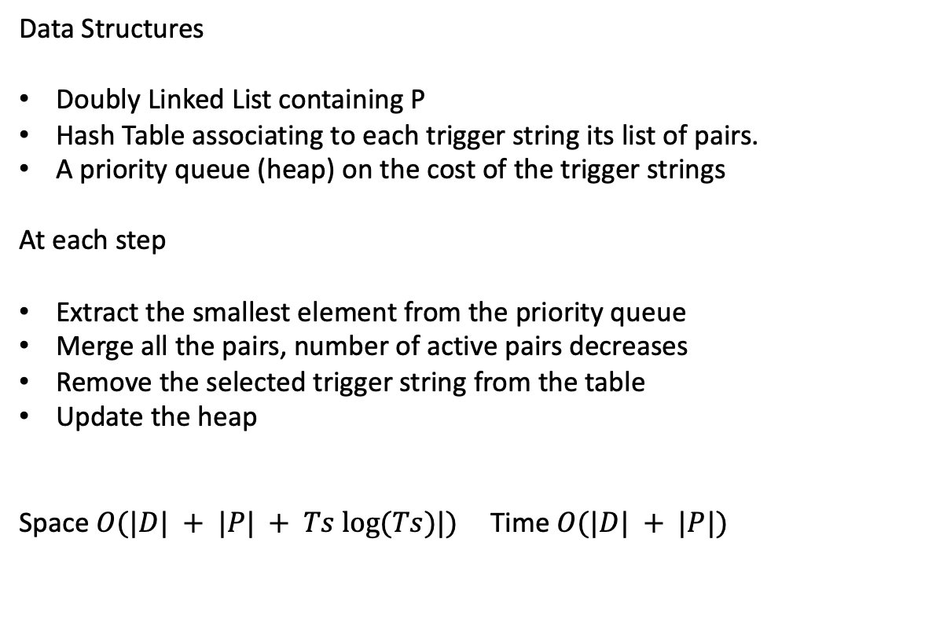
  Analysis
Background
PFP
AuPair
Motivation
TS Graph
Costs
Example
Experiments
Requirements
Compression
Effects of w and p
Data Structures
Doubly Linked List containing P
Hash Table associating to each trigger string its list of pairs.
A priority queue (heap) on the cost of the trigger strings
At each step
Extract the smallest element from the priority queue
Merge all the pairs, number of active pairs decreases
Remove the selected trigger string from the table
Update the heap
Space $O(|D| + |P| + Ts log⁡(Ts)|)$ Time $O(|D| + |P|)$

Slide 26
  Analysys
Fixed Size Linked List to store the list of pairs
1 | 12 | 3 | 0 | 0 | 3 | 4 | 8 | 2 | 2 | 5 | 15 | 0 | 0 | 0 | 0
0 | 0 | 1 | 1 | 1 | 1 | 0 | 0 | 1 | 1 | 0 | 0 | 1 | 1 | 1 | 1
Dictionary as an array and new phrases in a map
Cost updates in constant time

Slide 27
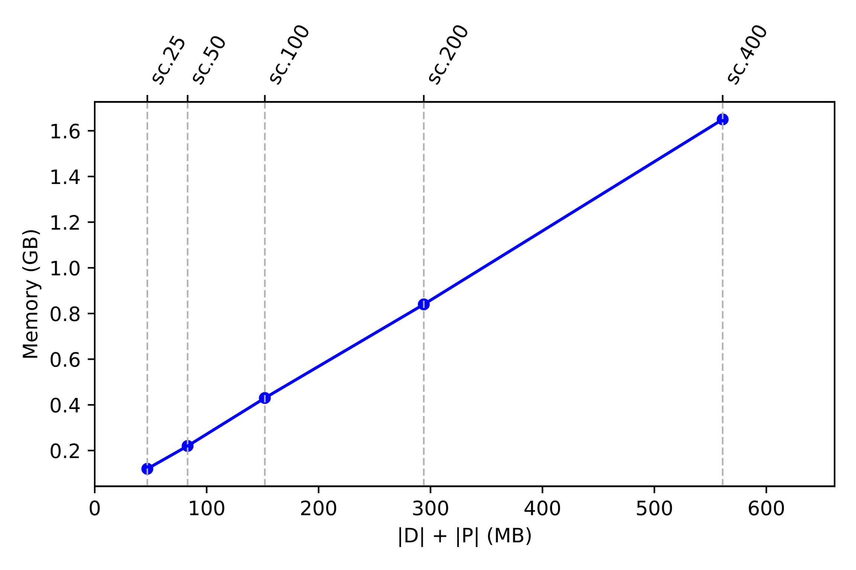
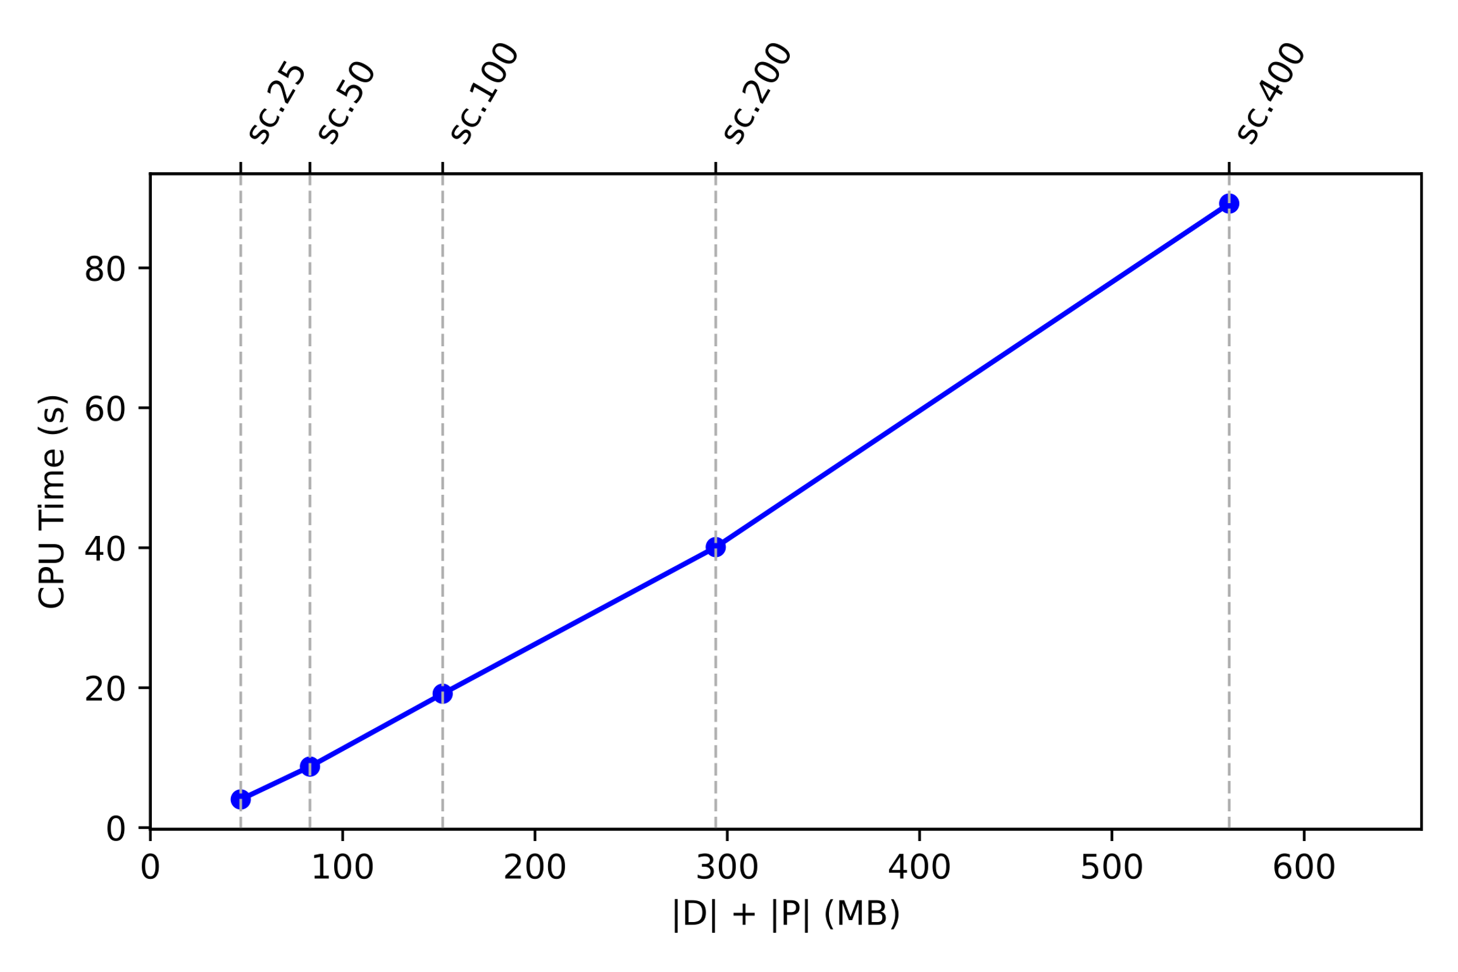
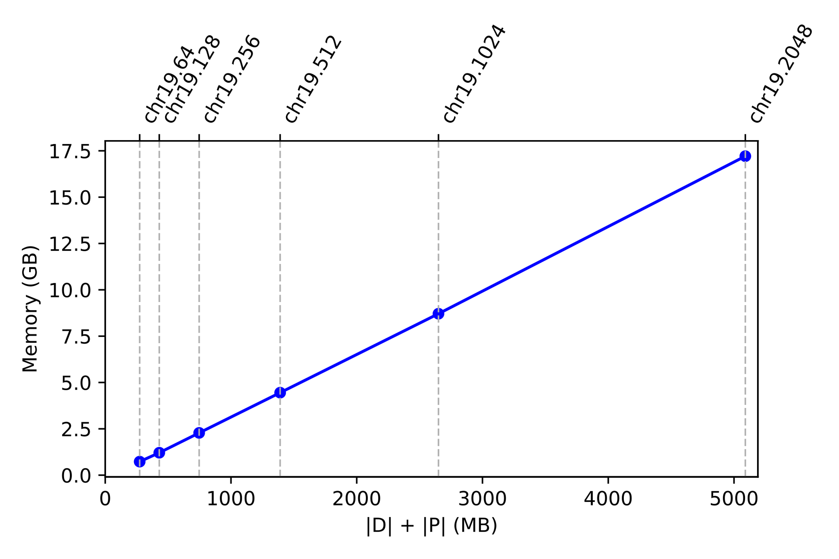

  Results
Background
PFP
AuPair
Motivation
TS Graph
Costs
Example
Experiments
Requirements
Compression
Effects of w and p

Slide 28
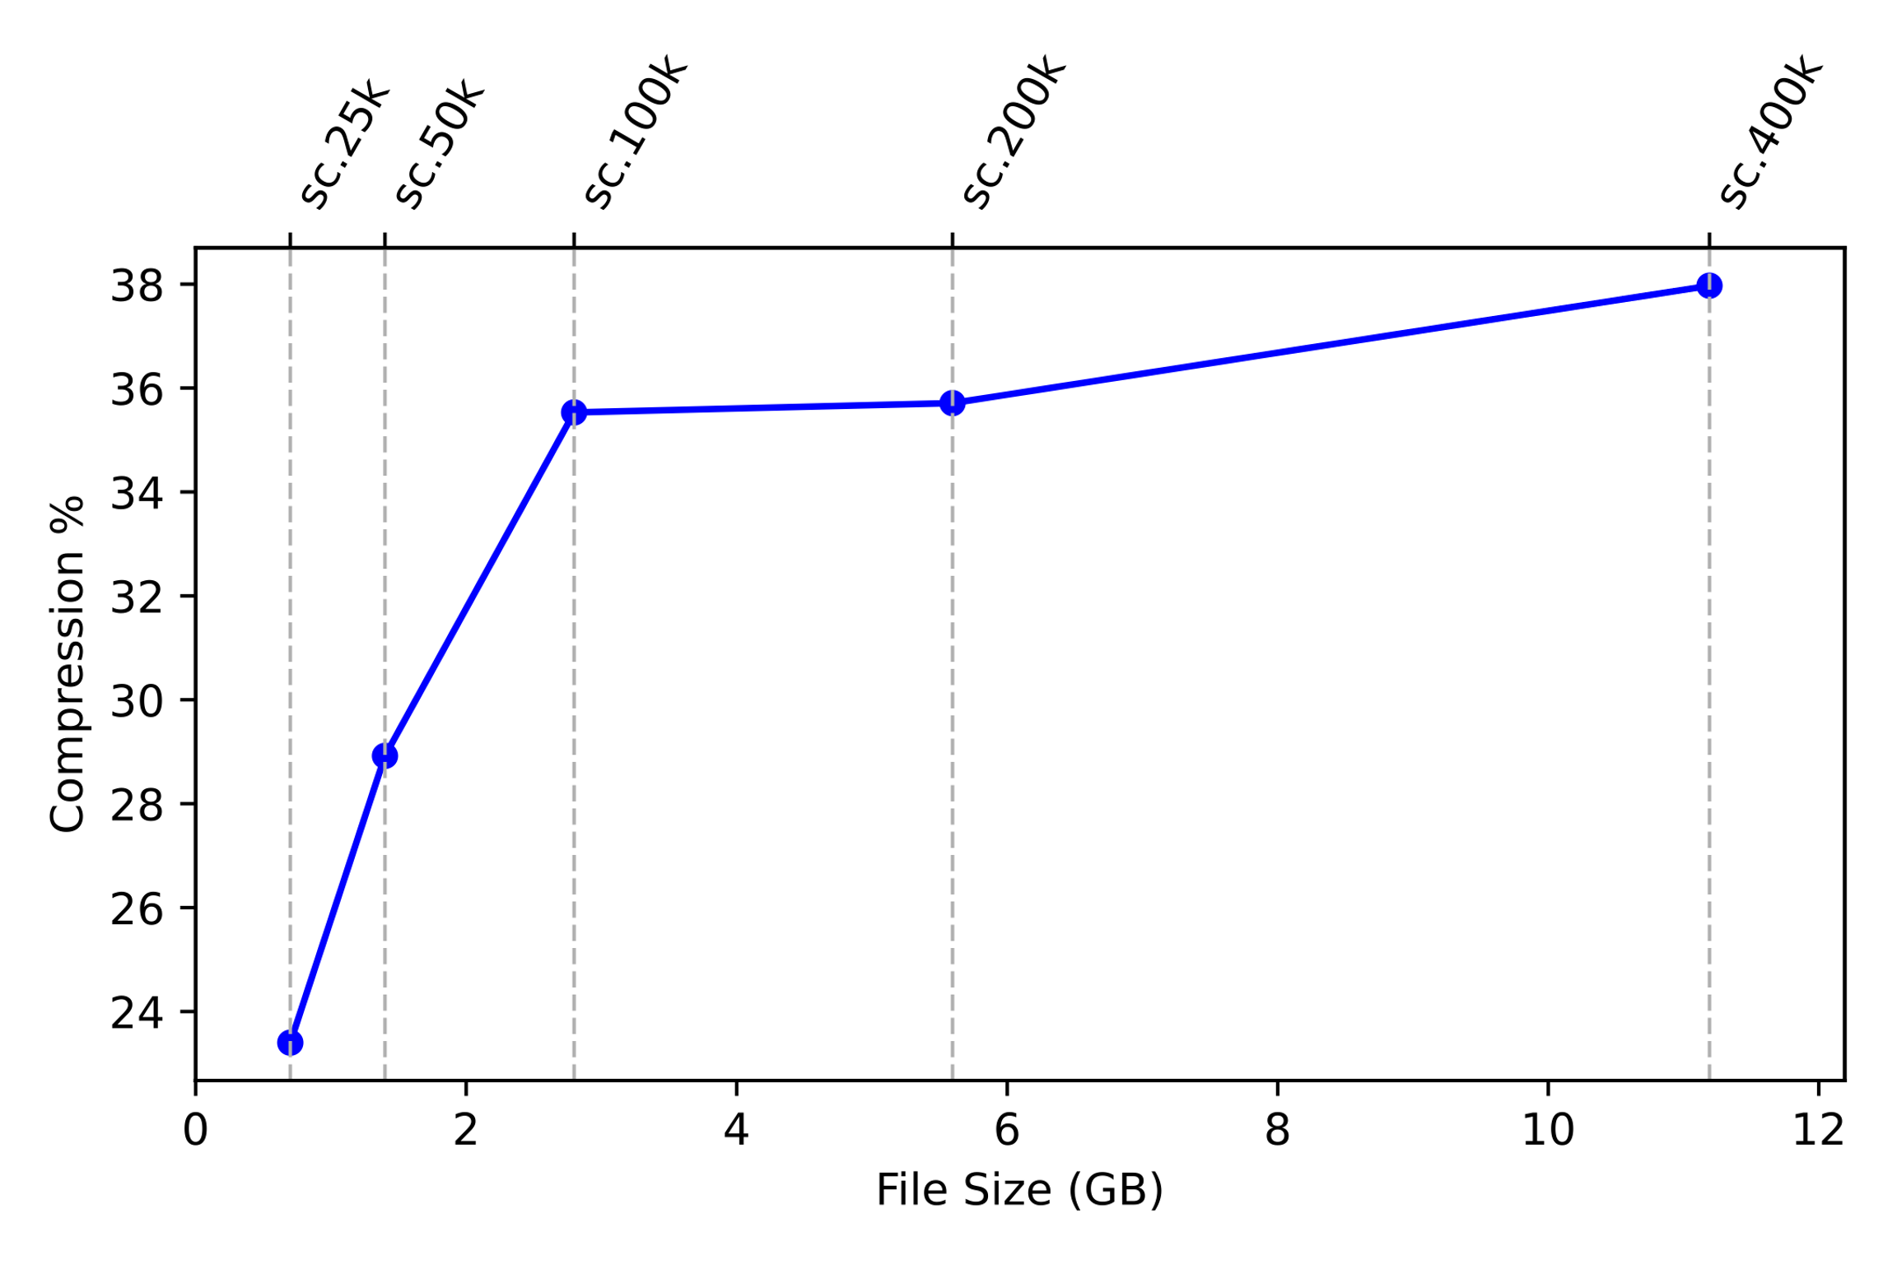
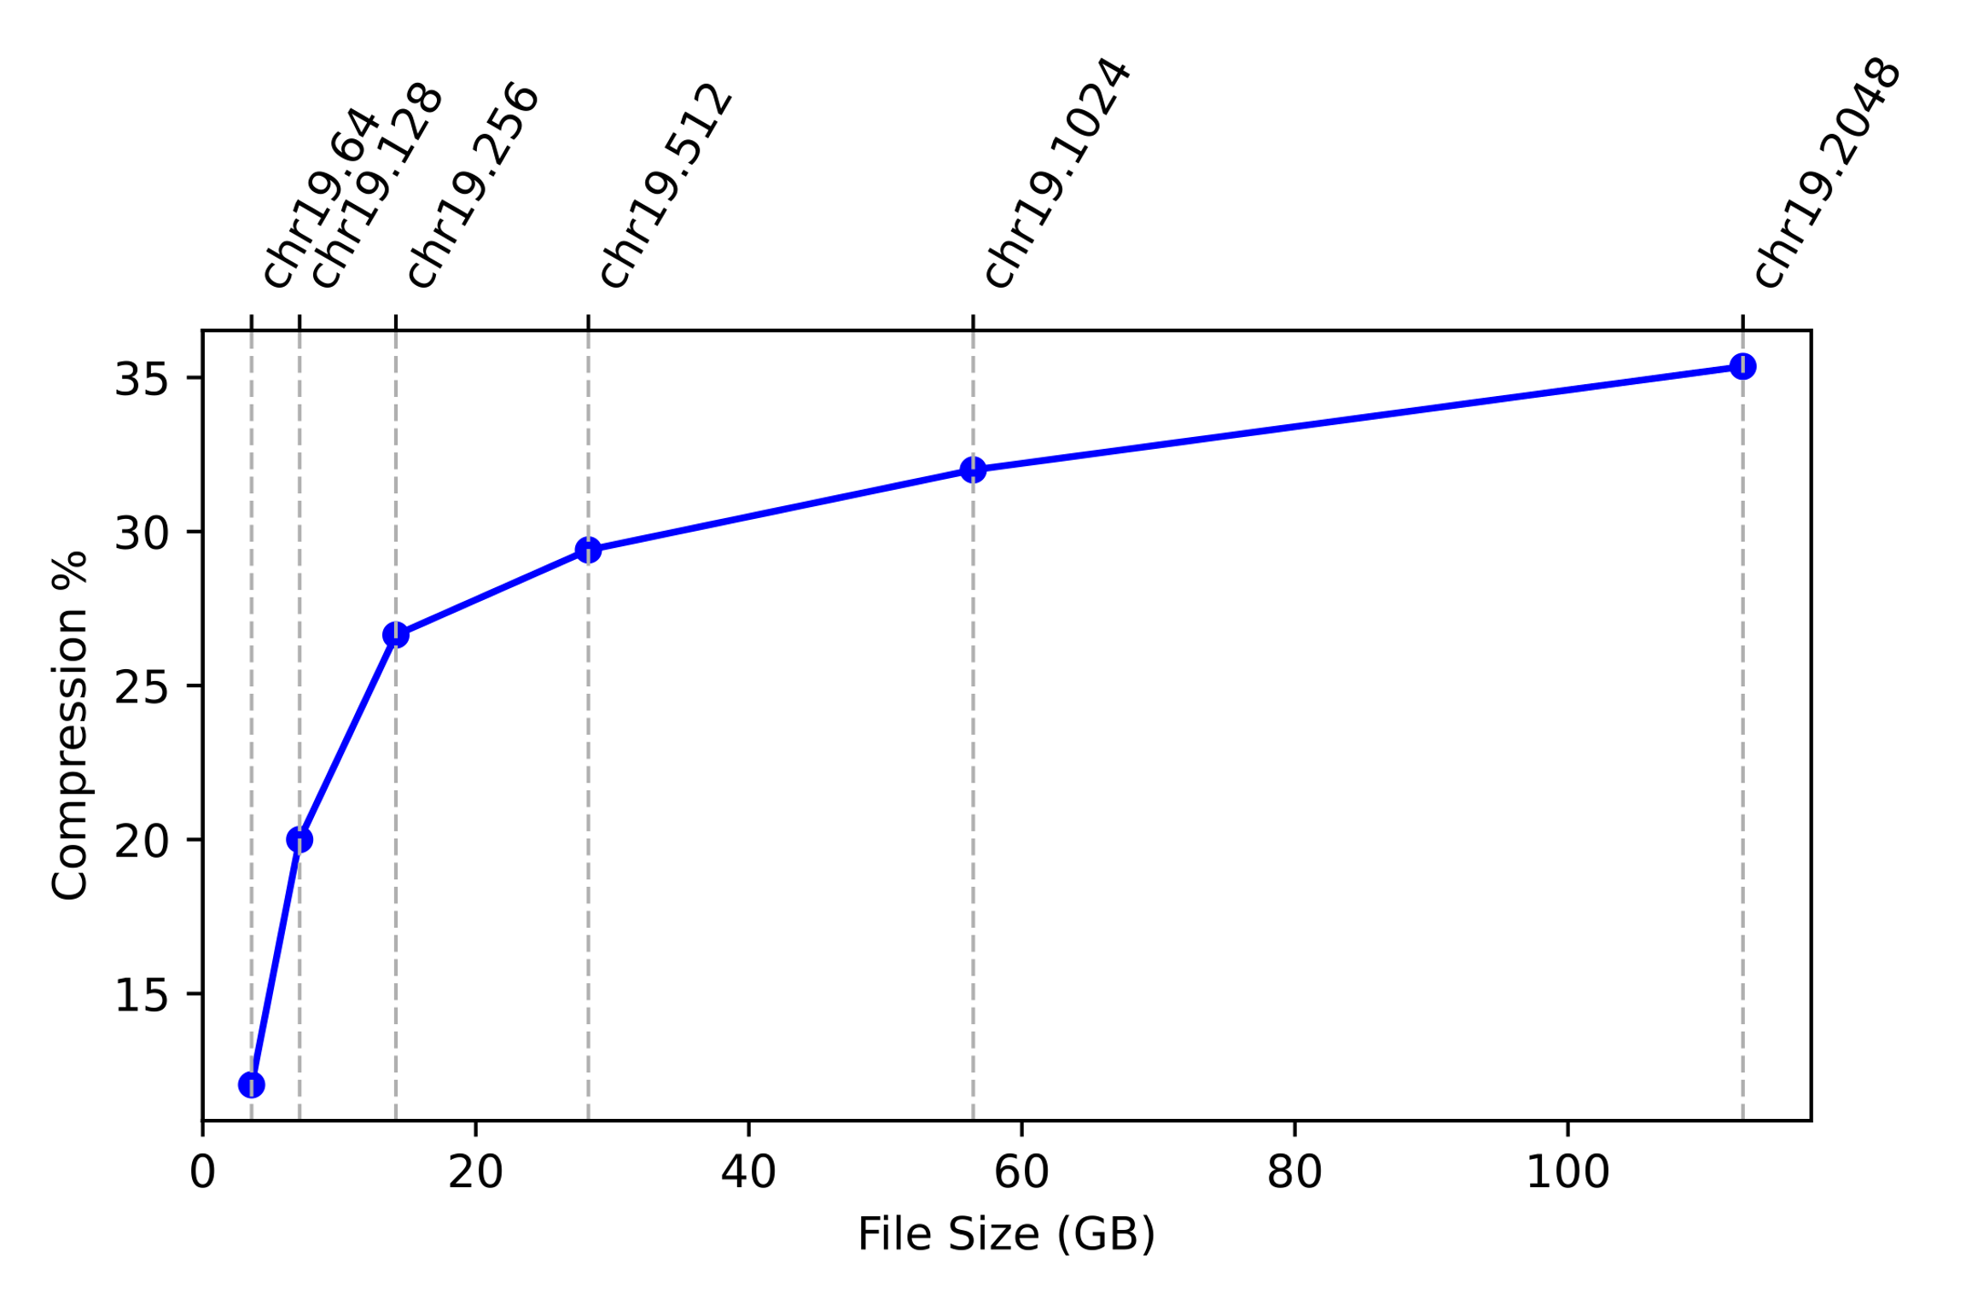
  Results
Background
PFP
AuPair
Motivation
TS Graph
Costs
Example
Experiments
Requirements
Compression
Effects of w and p
Dataset | File Size (GB) | D (MB) | P (MB) | D’(MB) | P’(MB)
sc.25k | 0.70 | 19 | 28 | 23 | 13
sc.50k | 1.40 | 28 | 55 | 35 | 24
sc.100k | 2.80 | 41 | 111 | 55 | 43
sc.200k | 5.60 | 74 | 220 | 96 | 93
sc.400k | 11.19 | 121 | 440 | 159 | 189
Dataset | File Size (GB) | D (MB) | P (MB) | D’(MB) | P’(MB)
chr19.64 | 3.58 | 129 | 145 | 157 | 84
chr19.128 | 7.10 | 143 | 287 | 197 | 147
chr19.256 | 14.15 | 176 | 571 | 277 | 271
chr19.512 | 28.25 | 252 | 1139 | 444 | 538
chr19.1024 | 56.44 | 375 | 2275 | 730 | 1072
chr19.2048 | 112.82 | 543 | 4547 | 1167 | 2123

Slide 29
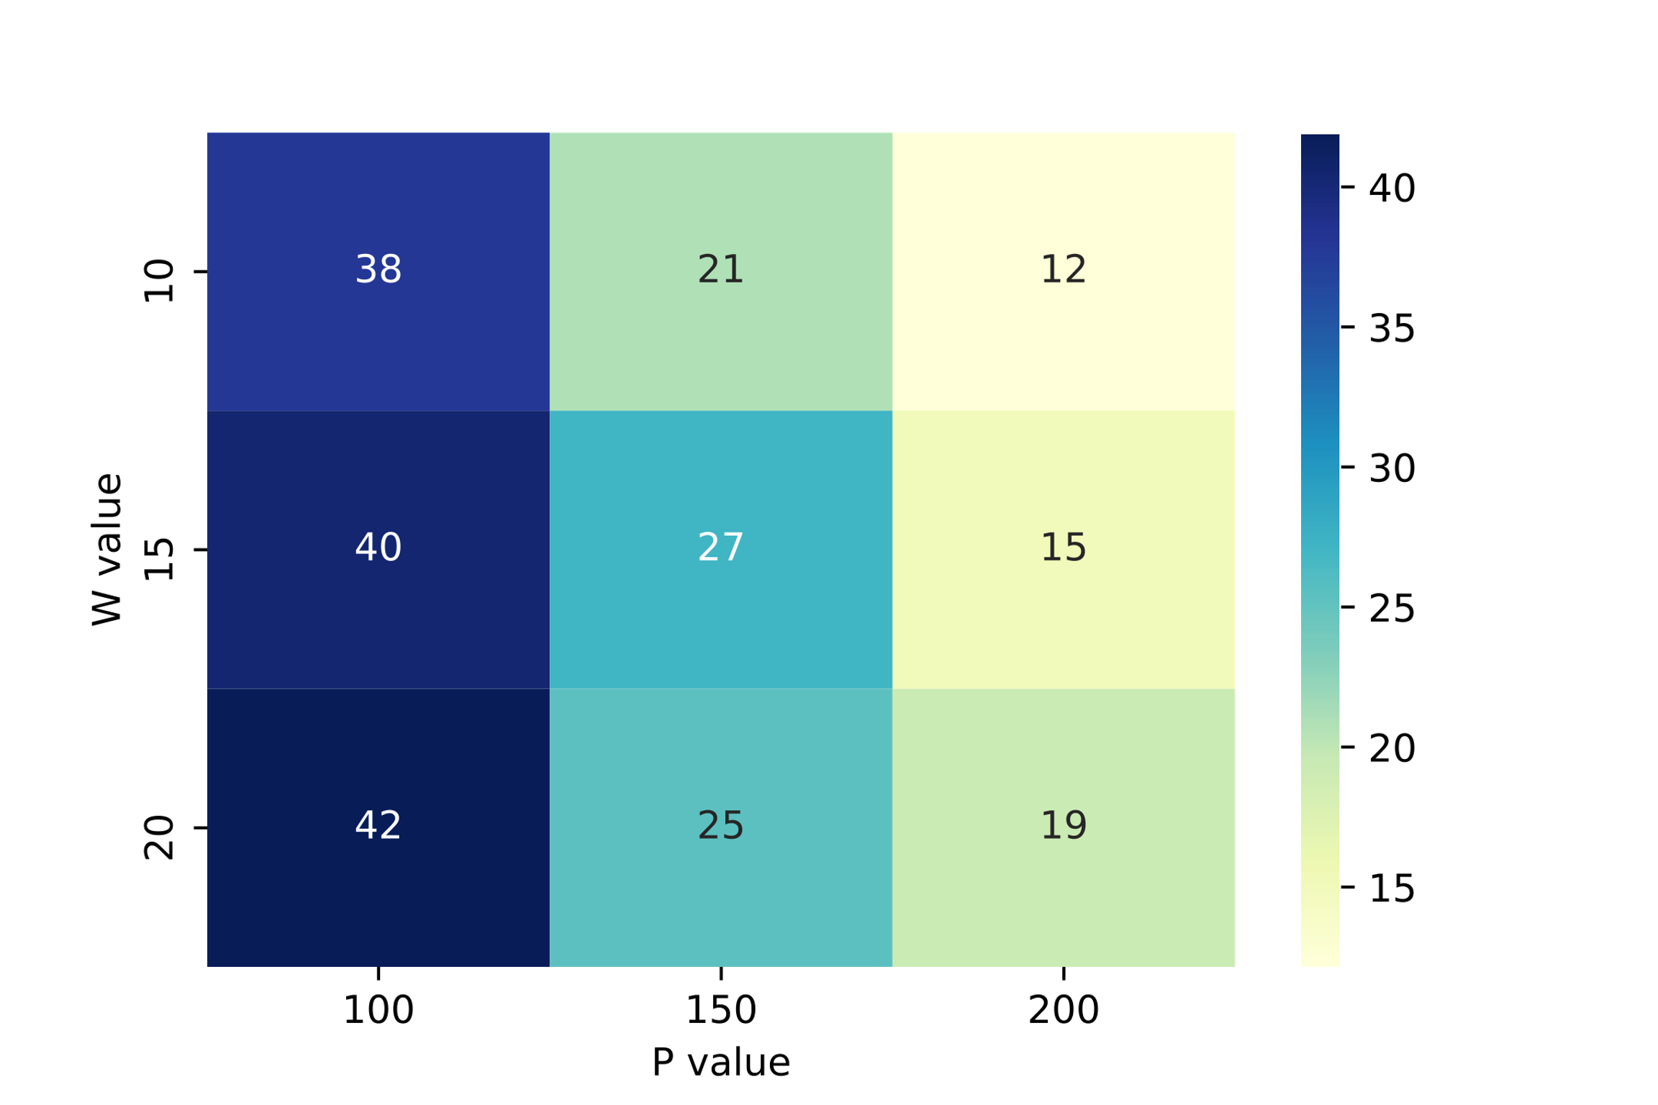
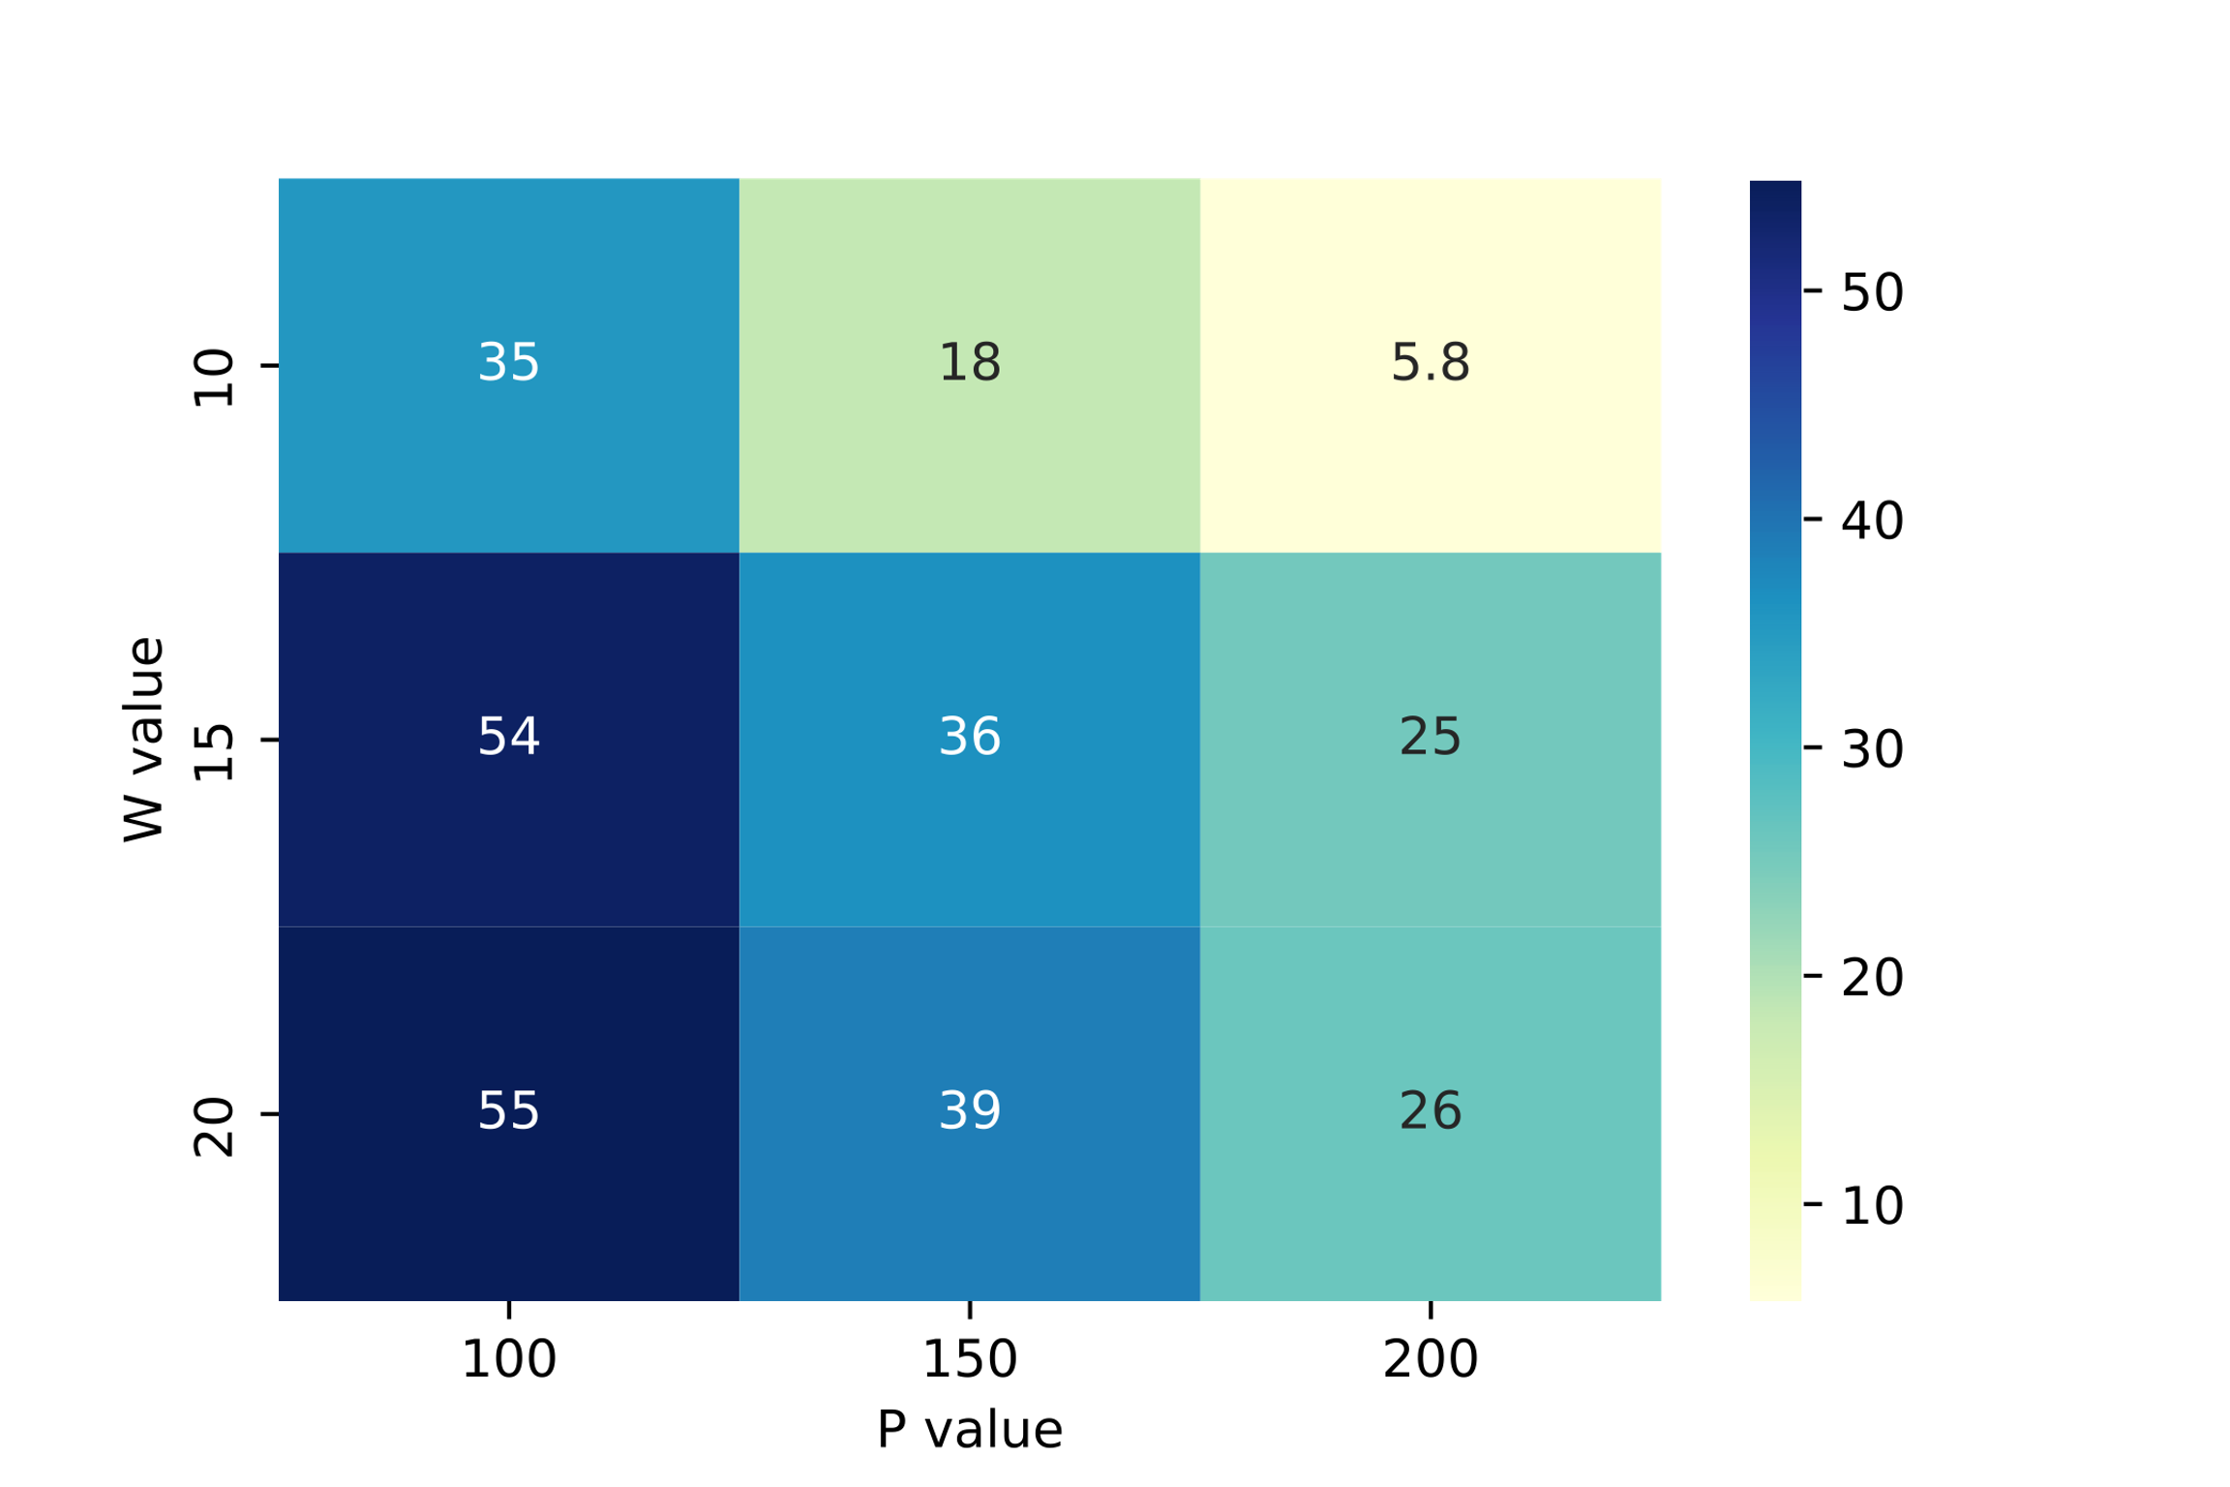
  Results
Background
PFP
AuPair
Motivation
TS Graph
Costs
Example
Experiments
Requirements
Compression
Effects of w and p
SARS Covid 19
W value | P value | D (MB) | P (MB) | D’(MB) | P’(MB)
10 | 100 | 121 | 440 | 159 | 189
10 | 150 | 173 | 292 | 198 | 170
10 | 200 | 340 | 228 | 361 | 138
15 | 100 | 123 | 469 | 166 | 187
15 | 150 | 162 | 321 | 196 | 156
15 | 200 | 228 | 230 | 247 | 142
20 | 100 | 126 | 482 | 167 | 186
20 | 150 | 182 | 318 | 214 | 159
20 | 200 | 206 | 258 | 229 | 146
Chromosome 19
W value | P value | D (MB) | P (MB) | D’(MB) | P’(MB)
10 | 100 | 543 | 4547 | 1167 | 2123
10 | 150 | 885 | 3203 | 1419 | 1919
10 | 200 | 1465 | 2032 | 1780 | 1516
15 | 100 | 599 | 4441 | 1163 | 1171
15 | 150 | 931 | 2963 | 1387 | 1088
15 | 200 | 1177 | 2255 | 1524 | 1037
20 | 100 | 697 | 4522 | 1257 | 1096
20 | 150 | 917 | 3001 | 1362 | 1044
20 | 200 | 1285 | 2255 | 1629 | 982

Slide 30
Background
PFP
AuPair
Motivation
TS Graph
Costs
Example
Experiments
Requirements
Compression
Effects of w and p
  Thank you!

